Slide 1

Hydrogen Electrolyser
Presented by Nikunj Mahajan

Slide 2
Introduction
What is a PEM Electrolyser?
PEM Electrolyser stands for Proton Exchange Membrane Electrolyser.
It uses electricity and water to produce hydrogen gas and oxygen gas through electrolysis.
It uses a solid polymer membrane as an electrolyte to conduct protons (H⁺ ions). Water (H₂O) is split into hydrogen (H₂) at the cathode and oxygen (O₂) at the anode.
Why do we need it?
We can store electrical energy in the form of chemical energy (Hydrogen gas), which can be used as a fuel.
It gives high purity hydrogen output
It offers Compact and efficient design

Slide 3

Electrolyser Cell
This mechanism uses a small, precisely designed electrolysis cell with an active area of just 9 cm². This compact size helps reduce variations in temperature and flow, making the results more accurate. At the core of the cell is a membrane electrode assembly (MEA) made of a polymer membrane coated with platinum (Pt) on the cathode and iridium oxide (IrO₂) on the anode. These materials serve as catalysts to speed up the chemical reactions. The MEA is placed between two porous titanium layers, which allow gas and water to move efficiently in and out.
To keep the membrane evenly compressed (which is critical for performance and leak prevention), the design uses springs that apply steady pressure, even when the outer bolts are tightened for sealing. To resist corrosion, especially under high-pressure and acidic conditions, all stainless-steel parts in contact with fluids are gold-coated. This design ensures safe and reliable operation at both high and low pressures, maintaining consistent performance during all tests.

Slide 4
Experimental Setup and Design
The SETUP includes two flowpaths: one for oxygen and one for hydrogen. Water is added on the anode side and Oxygen and Hydrogen are liberated on the anode and cathode side respectively. The hydrogen loop uses natural circulation. The water is kept pure using ion exchangers to avoid corrosion. The temperature is controlled with heaters (at 343 K). The whole system is made of corrosion-resistant stainless steel and is built to handle pressures up to 100 bar with a high safety margin. Every part is carefully monitored using sensors for temperature, pressure, and water levels.

Slide 5
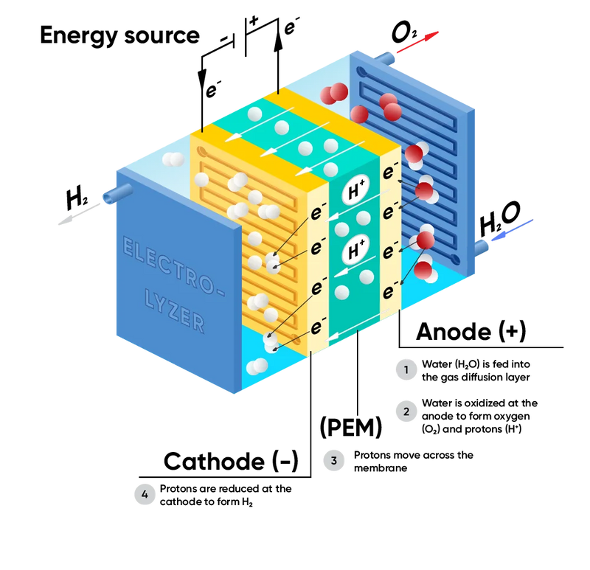
Design
Cell operates at 70°C and 1.5 A/cm².
Water inlet on is on the Anode side
The oxygen and hydrogen exit is on anode side and cathode side respectively.
Small 9 cm² cell to avoid flow gradients.
Proper Compression for uniform pressure on the structure.
Purpose of differential pressure
Producing hydrogen at high pressure (up to 100 bar) is important for easier storage and transportation. Normally, this requires extra compressors, but the system in this study can do it directly, making things simpler and cheaper. High pressure also helps avoid the need for drying the gas.

Slide 6
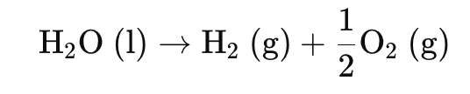
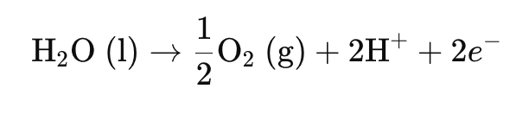

REACTIONS
In a polymer electrolyte membrane (PEM) electrolyser, water is split into hydrogen and oxygen using electrical energy. The overall reaction is:
This takes place in two half-reactions, one at the anode and one at the cathode:
Anode Reaction (Oxygen Evolution Reaction - OER):
At the anode, water is oxidized to produce oxygen gas, protons (H⁺), and electrons:
Cathode Reaction (Hydrogen Evolution Reaction - HER):
At the cathode, the protons (H⁺) generated at the anode move through the PEM membrane and are reduced by electrons to form hydrogen gas:

Slide 7
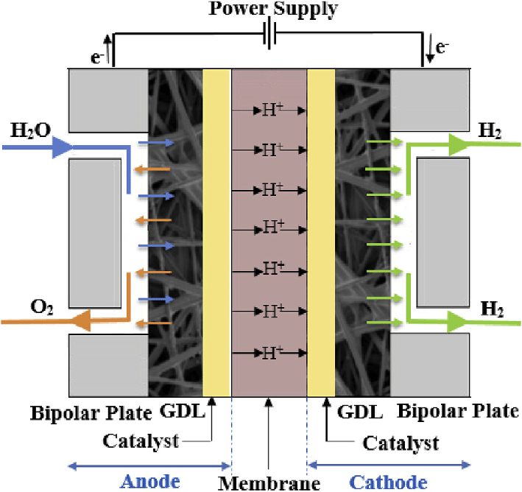
Layer by Layer breakdown of PEM Electrolyser
1. End Plates: They provide mechanical support and seal the electrolyser stack. They are made of Stainless steel, aluminum, or composite material.
2. Bipolar Plates: They conduct electrons to/from the electrodes, distribute gases and cooling fluid. They are made of Titanium (often with coatings like platinum or iridium to resist corrosion in PEM systems).
3. Flow Channels: These channels guide water into the cell and remove produced gases (H₂, O₂). We are using parallel channel designs.
4. Gas Diffusion Layer (GDL): Its function is to uniformly distribute gases over the catalyst layer and manage water transport. It can be made from porous carbon paper or titanium mesh for PEM; nickel for alkaline.
5. Catalyst Layer: This layer catalyzes the electrochemical reactions.
Anode (Oxygen Evolution Reaction, OER): IrO₂, RuO₂
Cathode (Hydrogen Evolution Reaction, HER): Pt/C
6. Proton Exchange Membrane (PEM): It conducts protons (H⁺) while acting as a gas separator.Its thickness ranges typically from 50 to 200 μm.
7. Mirror Image of Layers on the Other Side: The structure is symmetrical with a mirror set of GDL, flow field, bipolar plate, and end plate on the other side of the membrane to complete the cell.

Slide 8
Advantages and Challenges in High-Pressure PEM Electrolyzers
Advantages
Challenges
Method to store Electrical Energy in the form of a Higher grade energy (i.e. Chemical Energy)
Highly efficient with zero carbon footprint
Reduced system cost for operation at high pressure
Improvement of cell and stack performance
Higher rate of wear and tear of components due to exposure to high pressure

Slide 9
How Pressure and Temperature Affect Electrolyzer Performance
In a PEM electrolyzer, pressure and temperature play an important role in how efficiently the system works.
Pressure Effects:
When using differential pressure (hydrogen side pressurized), increasing the pressure leads to a higher cell voltage, as expected. This matches theory because more energy is needed to compress hydrogen during formation.
However, in balanced pressure mode (both hydrogen and oxygen sides are pressurised equally), the voltage increase is not significant. This suggests some beneficial side effects—like faster oxygen evolution or better gas transport
Temperature Effects:
When the temperature is increased from 30°C to 70°C, the electrolyser works more efficiently.
The main reason is the membrane’s resistance decreases at higher temperatures, allowing protons to move more easily.
As a result, the overall cell voltage drops, meaning less energy is needed to split the water.

Slide 10
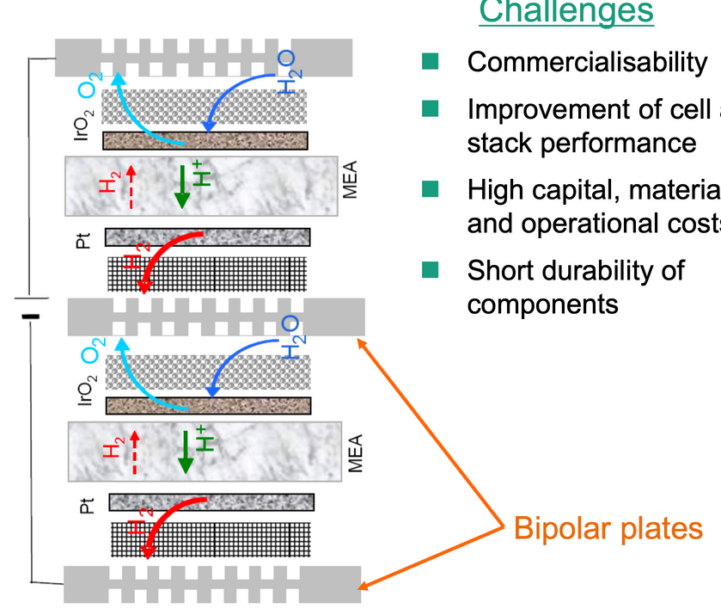
BIPOLAR PLATE
Bipolar plates (BPP) are flat separator plates (with flow field channels) used to match the power supply voltage by stacking multiple electrolysis cell units in series. Take separate adjacent units and connect them electronically. It needs to have low resistance and high mechanical and chemical stability, fluid distribution, and high thermal conductivity as it also helps to promote heat transfer.
Multiple functions of a bipolar plate
1. Electrical Conduction
Function: Conduct electrons between adjacent cells in a stack (from the anode of one cell to the cathode of the next).
Importance: Ensures efficient current collection with minimal resistive losses.
2. Gas and Water Distribution
Function: Uniformly distribute reactant gases (e.g., H₂, O₂ in fuel cells; H₂O in electrolysers) to the electrodes through flow channels.
Importance: Ensures efficient electrochemical reaction by maintaining reactant availability.

Slide 11
3. Heat Management
Function: Conduct and dissipate heat generated during operation.
Importance: Maintains optimal cell temperature, prevents thermal hotspots, and supports system durability.
4. Mechanical Support and Sealing
Function: Provide structural integrity to the cell and compress the membrane electrode assembly (MEA).
Importance: Maintains proper contact between layers, prevents gas leakage, and ensures longevity.
5. Product Removal
Function: Remove reaction products after a certain pressure is reached (e.g., hydrogen and oxygen gases).
Importance: Prevents flooding or gas blockage, ensuring performance stability.
6. Separation of Reactants
Function: Physically separate the anode and cathode gases in adjacent cells to prevent mixing.
Importance: Avoids hazardous cross-contamination (especially critical for H₂ and O₂ separation in electrolysers).

Slide 12
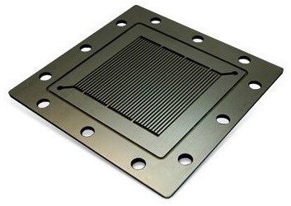
Design Elements
Important Aspects in Design of a bipolar plate:
1. Mechanical Stability
Must withstand high pressures (up to 100 bar) without deforming.
Supports uniform compression of the MEA and ensures good sealing to prevent leaks.
2. Electrical Conductivity
Transports electrons efficiently from one cell to the next in a stack.
Requires low contact resistance for minimal energy loss—enhanced by gold/nickel coating.
3. Thermal Management
Must evenly distribute heat generated during electrolysis.
Prevents hot spots and supports stable operation, especially under varying loads.
4. Corrosion Resistance
In contact with acidic water, oxygen, and hydrogen—needs strong resistance to corrosion.
Made of stainless steel and coated with gold over nickel for durability and stability.
5. Flow Channels
Includes precision-cut channels to guide water and gases efficiently.
Ensures uniform distribution and minimizes pressure drops or flooding.

Slide 13
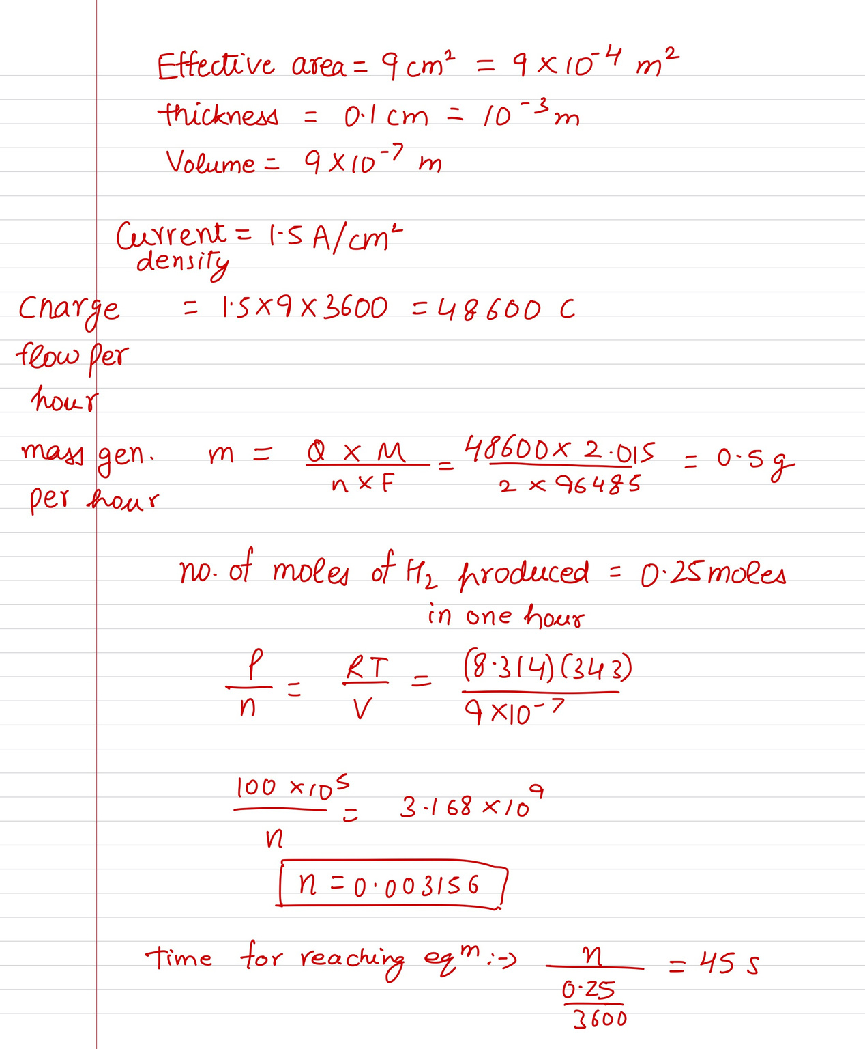
CALCULATIONS

Slide 14
Conclusion and Understandings
PEM Electrolyser is a mechanism that using the concept of hydrogen ion exchange through a membrane to generate Hydrogen gas from water. Our major part of research is on differential pressure electrolyser. The electrolyser splits water into hydrogen and oxygen using electricity—ideally from renewable sources—making it a key technology for a sustainable energy future.
Most importantly, I now see how every component—especially the bipolar plate—plays a critical role in the system. Designing it well is essential to building an efficient, high-pressure electrolyser that works reliably in real-world conditions.
The main focus of our work in this project will be the design of the bipolar plate for a high-pressure PEM electrolyser. This component plays a vital role in the system—it must handle high pressure, guide gases and water efficiently through its channels, resist corrosion, and maintain strong electrical conductivity. Our goal is to create a bipolar plate design that supports safe, stable, and high-performance operation under demanding conditions. This design will be the foundation for the overall success of the electrolyzer system we plan to develop.

